Slide 1


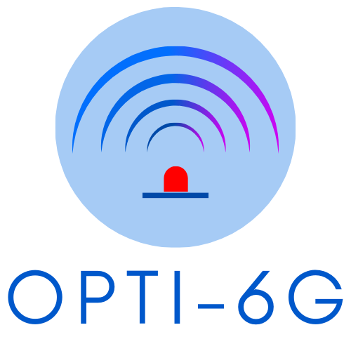


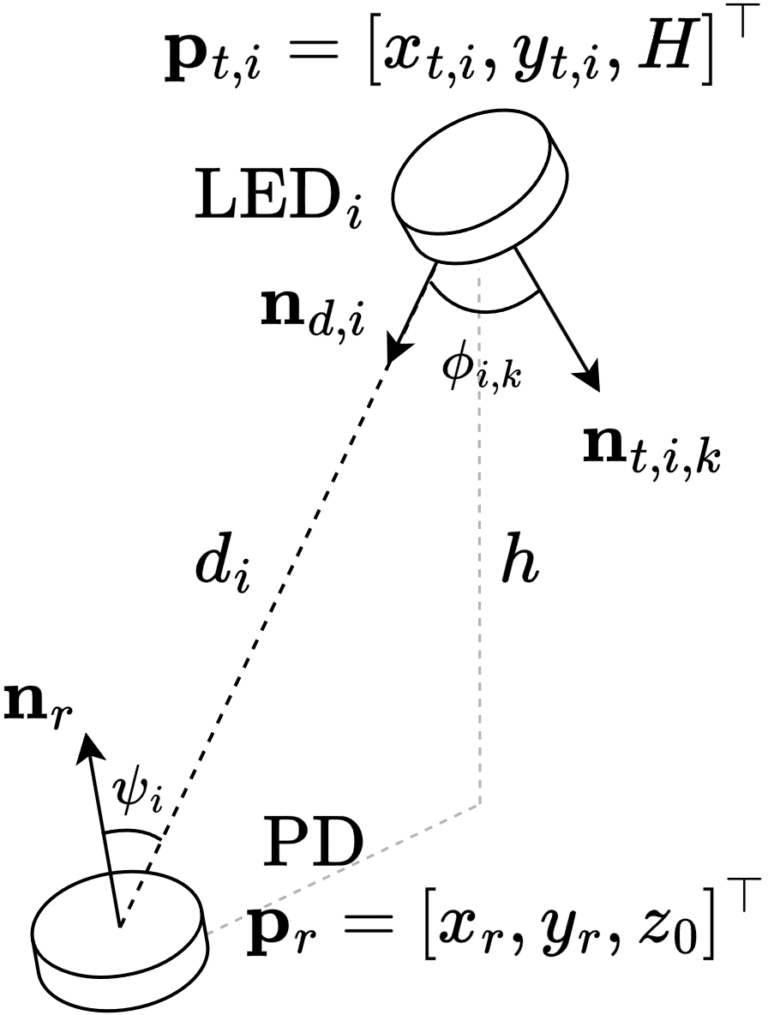
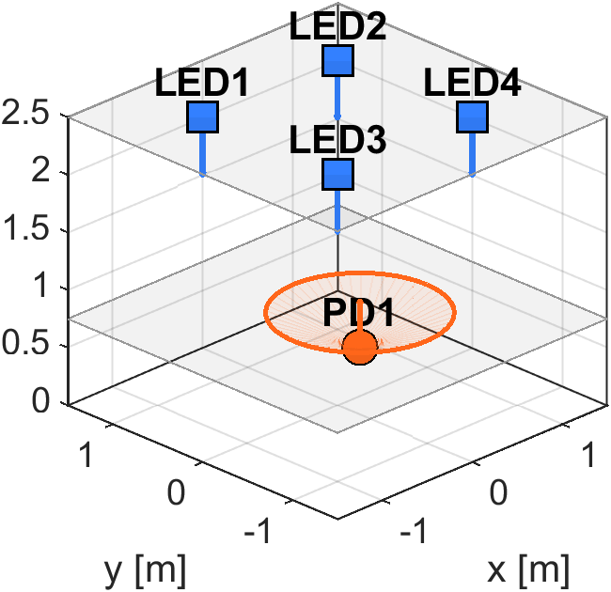
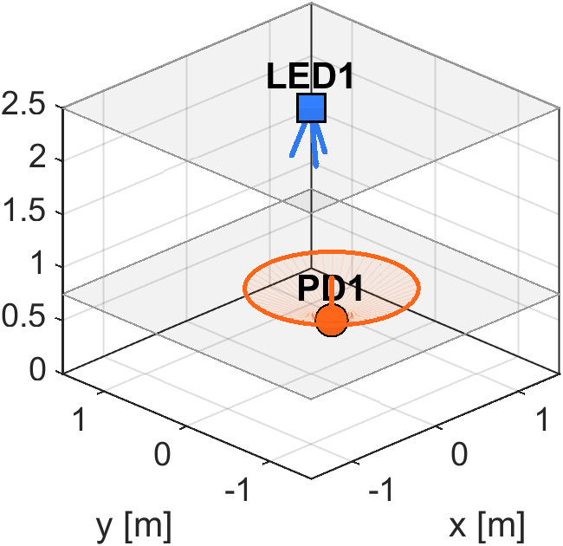
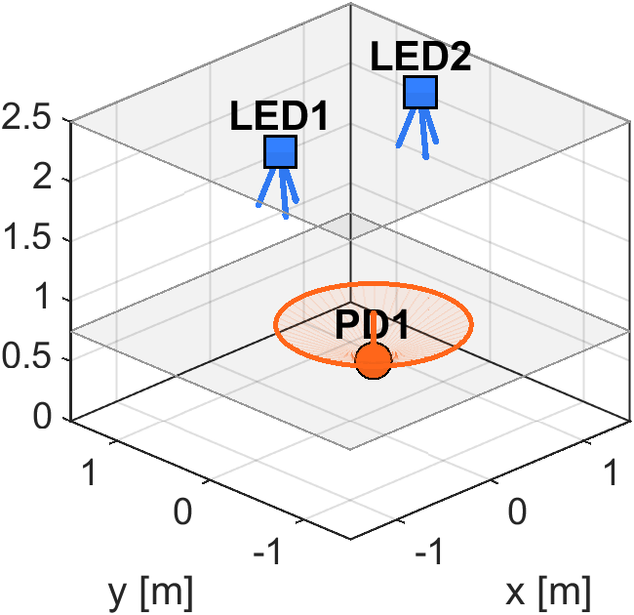
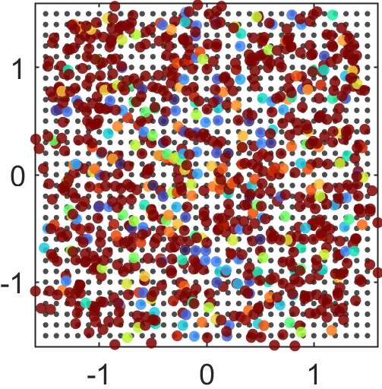
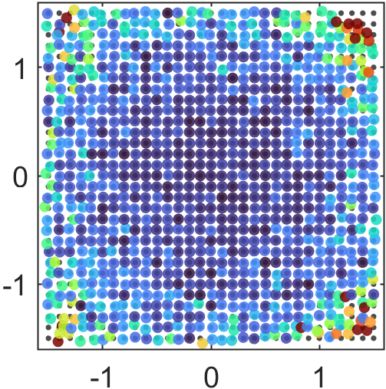
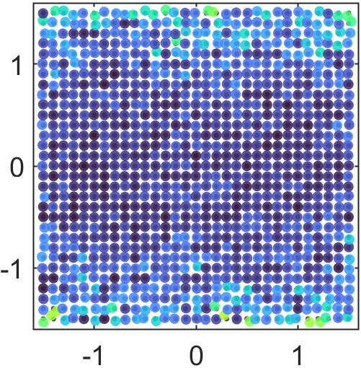
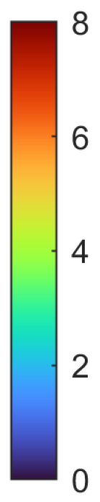

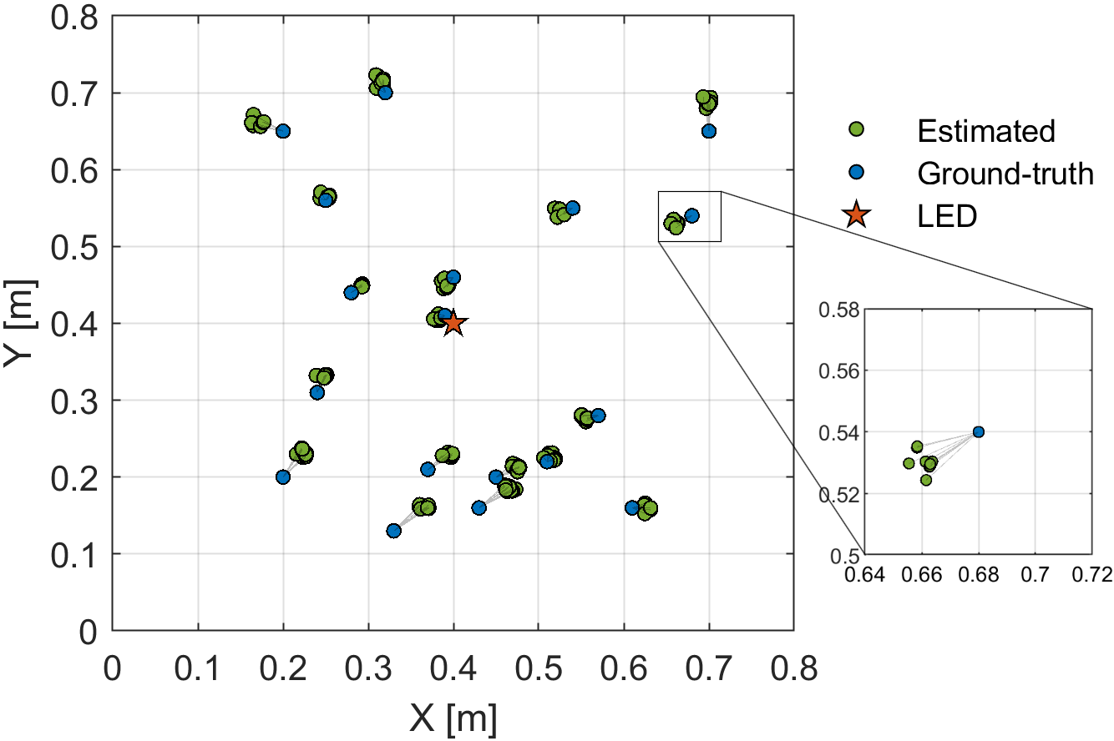

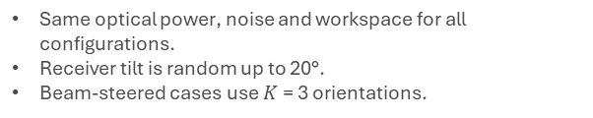
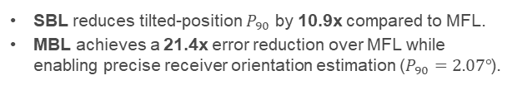

ROBUST OPTICAL WIRELESS POSITIONING WITH BEAM STEERING:
POSE ESTIMATION AND TILT ROBUSTNESS
Kevin Acuna-Condori, Bastien Béchadergue, Hongyu Guan, Luc Chassagne
LISV, Université Paris-Saclay – UVSQ
Key claim: Steering diversity makes received signal strength (RSS)-based optical wireless positioning (OWP) robust to receiver tilt and enables pose sensing.
01 Problem & Experimental Question
02 Method: Steer $→$ Ratio $→$ Solve
03 Results: Robustness to Receiver Tilt Uncertainty
Conventional RSS-based OWP assumes a vertical receiver.
Real devices tilt $→$ change in the optical channel $→$ multilateration becomes biased.
Steering the LED changes the RSS through changes in $φ_{i,k}$ but keeps $ψ_{i}$ common across orientations.
RSS ratios cancel the receiver-incidence factor, i.e., depend only on the receiver position.
Multiple RSS ratios form a linear system solved by singular value decomposition.
With ≥ 2 steerable LEDs, pose estimation also becomes possible.
Tilted-PD simulation $P_{90}$
Question: Can a controlled LED beam provide enough angular diversity to remove the tilt penalty without adding dense infrastructure?
34.45 cm
MFL
3.16 cm
SBL
1.61 cm
MBL
SBL reduces tilted-position $P_{90}$ by 10.9x compared to MFL.
MBL achieves a 21.4x error reduction over MFL while enabling precise receiver orientation estimation ($P_{90}=2.07°$).
Error heatmaps under random tilt (0-20°)
MFL: 4 fixed LEDs
SBL: 1 steerable LED
MBL: 2 steerable LEDs
Evaluation setup
MFL
SBL
MBL
Same optical power, noise and workspace for all configurations.
Receiver tilt is random up to 20°.
Beam-steered cases use $K$= 3 orientations.
Experimental SBL validation
RMSE
2.66 cm
Why it matters?
Indoor OWP/VLP systems are attractive, but robustness to practical device pose is a bottleneck.
APE
2.35 cm
WRMS
0.48 cm
Takeaway: SBL is the low-complexity tilt-robust option; MBL is the accuracy/pose-sensing option.
Beam steering is the enabling degree of freedom for practical OWP.

